Slide 1


PRONE POSITIONING: PRE-MANOUVRE
TEAM & UNIT
Unit Considerations & Assemble Team
Is the unit adequately staffed? Are staff adequately trained?
Team members: ICU senior medical, nursing +/- physio if available
Airway x 1, Move the trunk & limbs x 4 + 1x extra for lines and equipment
1
EQUIPMENT
Collect Equipment
Crash Cart, extra ECG dots
Fresh sheet x 2, slide sheets x 2, “foldable” pillows x 3
Ensure bed area clear to allow free movement of staff & equipment
2
General Considerations
R/V indications & contraindications
Hx of neck or spinal injury? Check neck Range of Motion – 90° L & R
Explain procedure to patient & family
PATIENT
3
Airway
Check ETT position on CXR, document lip level & fasten securely
Breathing
Treating Intensivist to confirm ventilator settings, ?pre-oxygenation
Circulation
Check vascular access is secure & taped
R/V hemodynamic trends - if unstable, discuss with Intensivist
Check in-line and yankeur suction are functioning
Ensure caponography functioning
Check cuff to ensure no cuff leak
Suction mouth, airway & nasal passages
Plan for haemodynamic instability and identify drug access point
Disability
Equipment & Lines
Ensure the patient is well sedated
Other
Secure all tubes, catheters & lines & remove unessential lines (consider extension tubing on IV access)
Consider disconnect RRT, aspirate NGT (if applicable) and spigot NGT
Dress anterior wounds including eye care
Mouth care
Lines from waist up: move up, lines from waist down: move down.
Plan for further sedation/paralysis as required
Pressure area care: consider adhesive pads to bony prominences

Slide 2
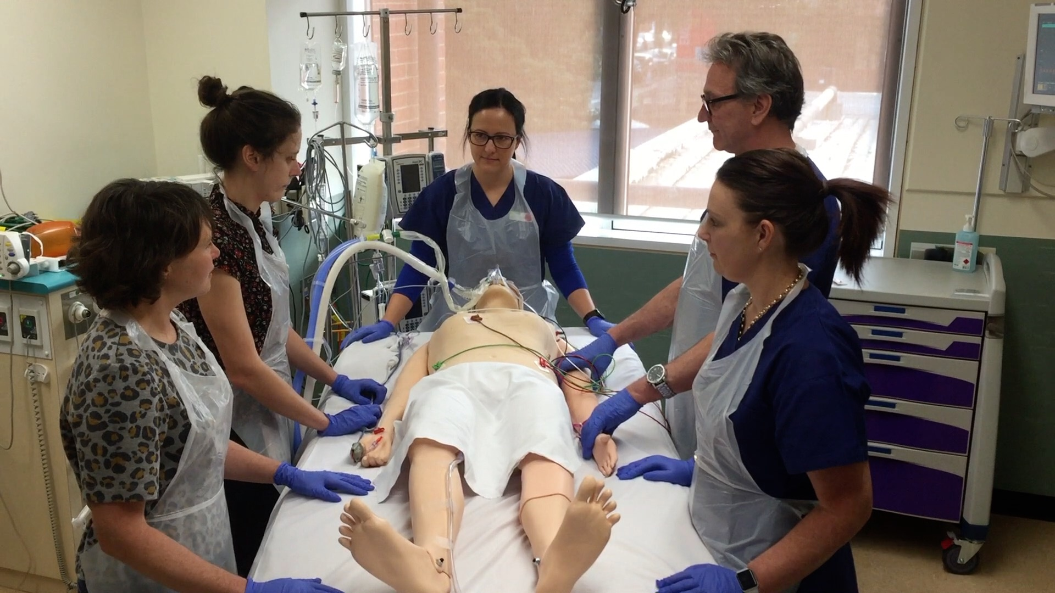
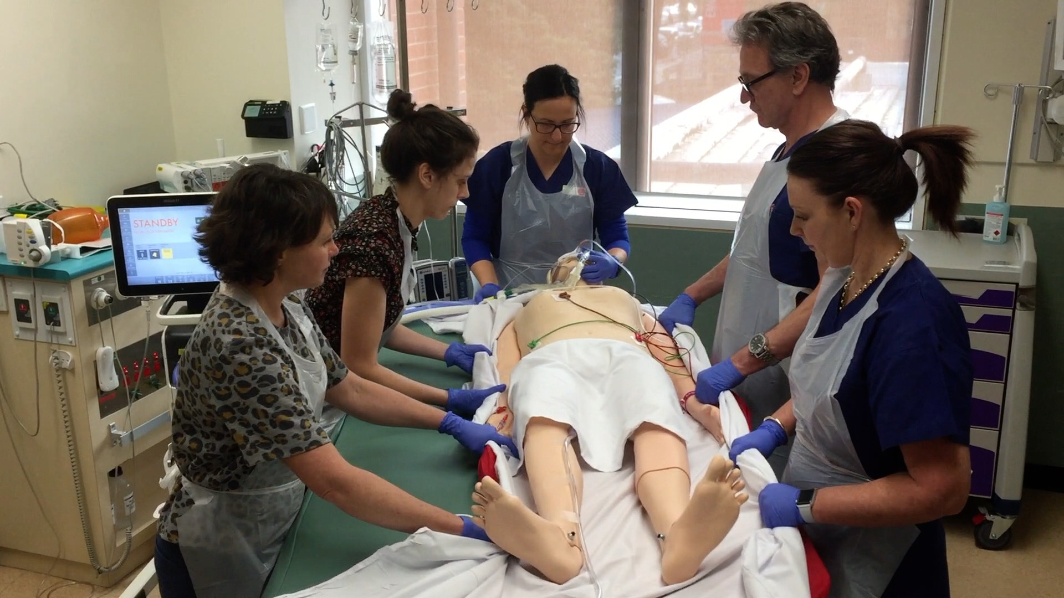
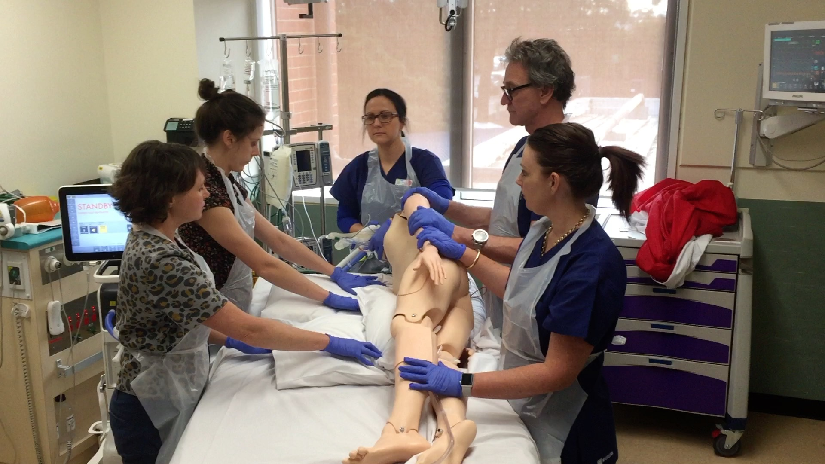
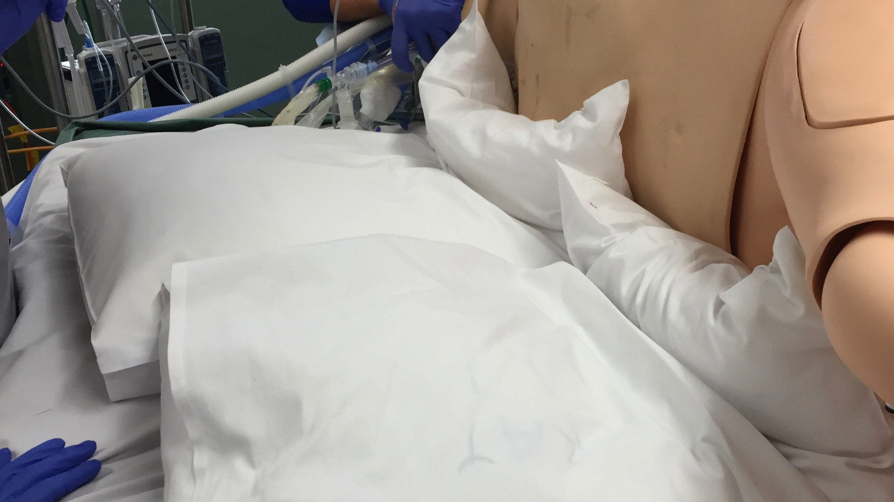
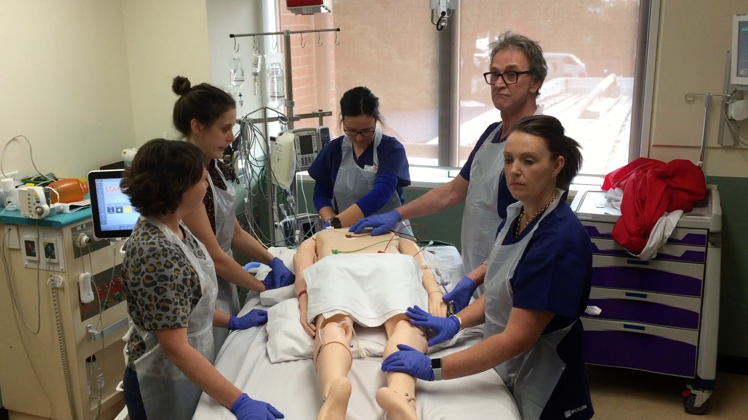
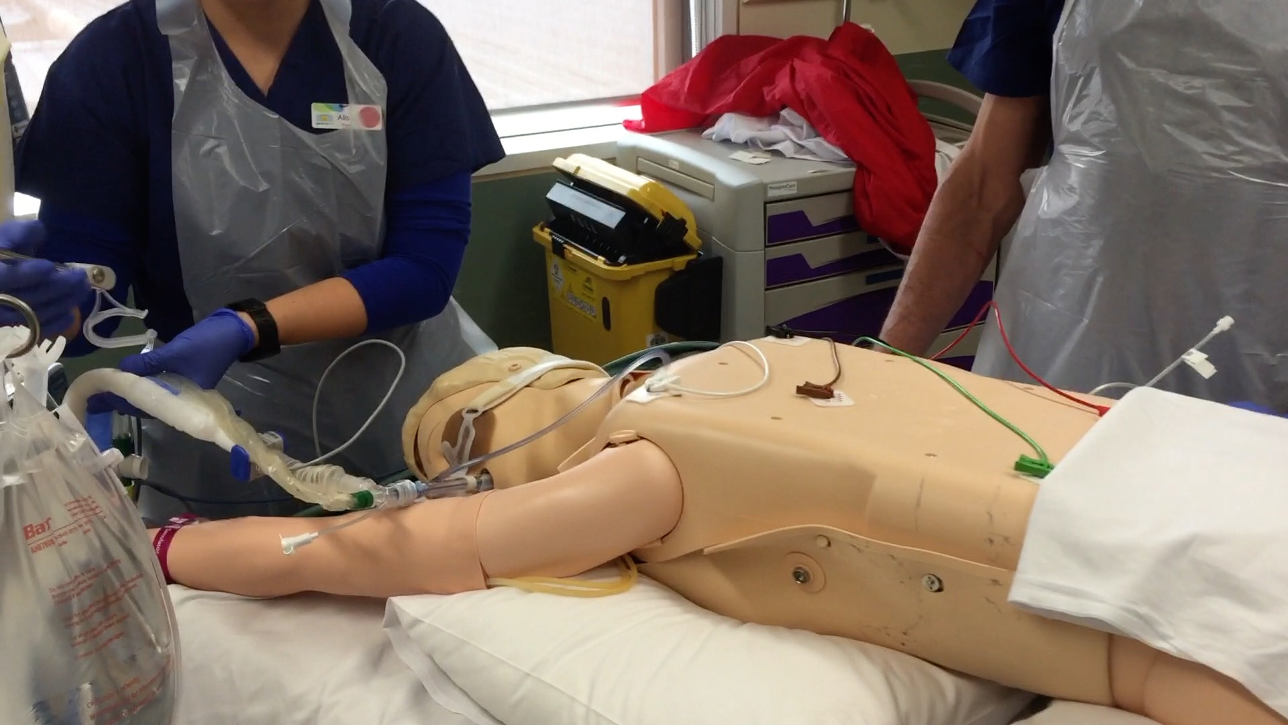
MANEOUVER POST-MANEOUVER
REGULAR CHECKS
Preparation
Position the team with the team leader at the head of the bed
Talk through the steps and decide on a turning direction (usually towards ventilator) & position ETT on opposite side
Remove patient’s head pillow and set air mattress to ‘firm’
Patient Position
Position arms for comfort with one arm above the head and the other by the side, shoulder in neutral
Reposition patient in the centre of the bed
Adjust pillows to ensure abdomen is hanging freely
Position and support head to reduce pressure on the eyes and enable airway access
Re-adjust lines for comfort and NGT on free drain
Horizontal Move
Move patient to the edge of the bed
Tuck the original sheet + one slide sheet under the patient
Tuck a new sheet and slide sheet on the side the patient will turn to
Airway
Check the ETT lip level and ventilator circuit for kinks regularly
Suction if indicated
Confirm cuff tube pressure
Side Lying Position
Tuck the arm on the side the patient will roll over under the buttock with the palm up (UN-PRONE: hand positioned on thigh, palm up)
Turn the patient into the lateral position
Untangle lines, remove ECG leads from anterior thorax to back (left to left, right to right)
Pull new sheet and slide sheet through if able, remove old sheet
Slide patient to the edge of the bed – away from ventilator
Fold pillows by a third and place in line with upper chest and pelvis (in line with hip bones)
Breathing
Auscultate for bilateral breath sounds
Check oxygen saturations
Check tidal volumes are equal to or greater than in supine position
Reassess PIPs and minute ventilation
Circulation
Monitor hemodynamic status
ABGs 30 minutes after turning prone
Complete Prone
Turn the patient onto their stomach in the prone position
Roll slightly to enable you to pull the folded pillows through
Position in the “Swimmer” position (see Patient Position on left)
Place a third pillow underneath the lower legs
Pressure Area Care
Set air mattress to previous setting and ensure fully functioning
Reposition head slightly each hour to reduce facial oedema, frequent eye toilets may be necessary
Ensure tongue is inside the mouth
Document a thorough skin assessment
Change patient position by tilting into the lateral position 20-30 degrees every 2 hours
Post Prone Management
Work through the steps opposite initially and at regular intervals while patient is in prone

